Slide 1

Task -1 :
Web Scraping to Gain Company Insights

Slide 2
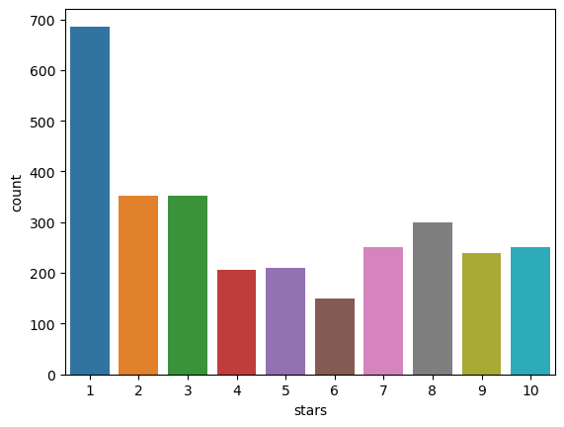
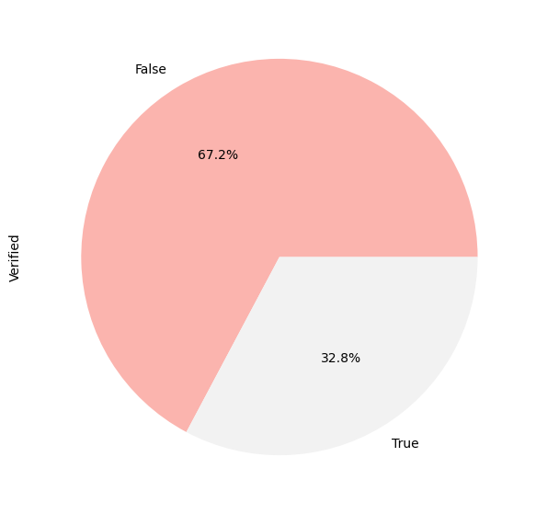
Insights from Customer Reviews and Rating :
From the pie plot 67.2% people has verified trips whereas 32.8% people has not verified trips.
Maximum count of rating 1 can be seen in the Count Plot.

Slide 3
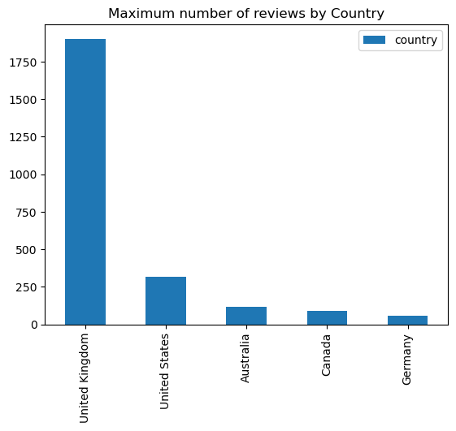
Total Country Reviews :
From the plot we can see United Kingdom has the highest number of reviews as compared to other countries.

Slide 4
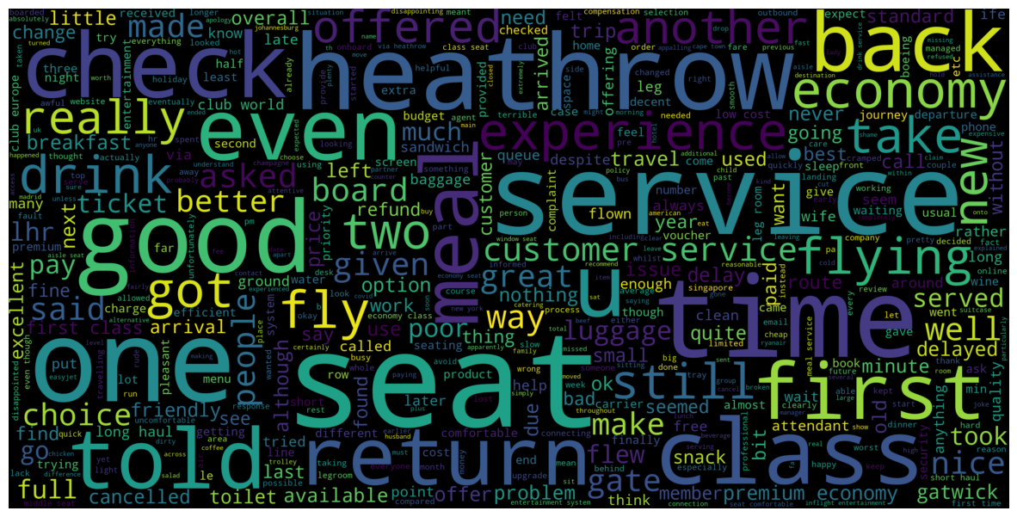
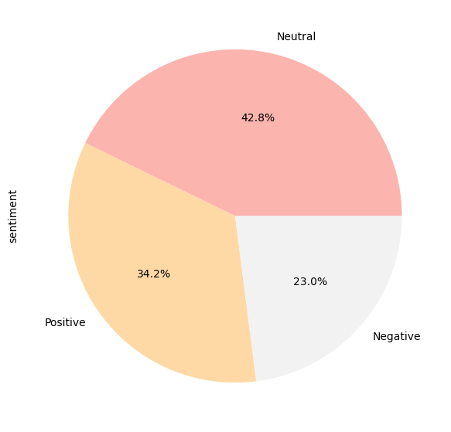
Sentiment Analysis :
From the sentiment analysis –
Neutral - 1283
Positive - 1027
Negative - 689
Word cloud of reviews :

